Slide 1
More Linear Regression Models

Slide 2
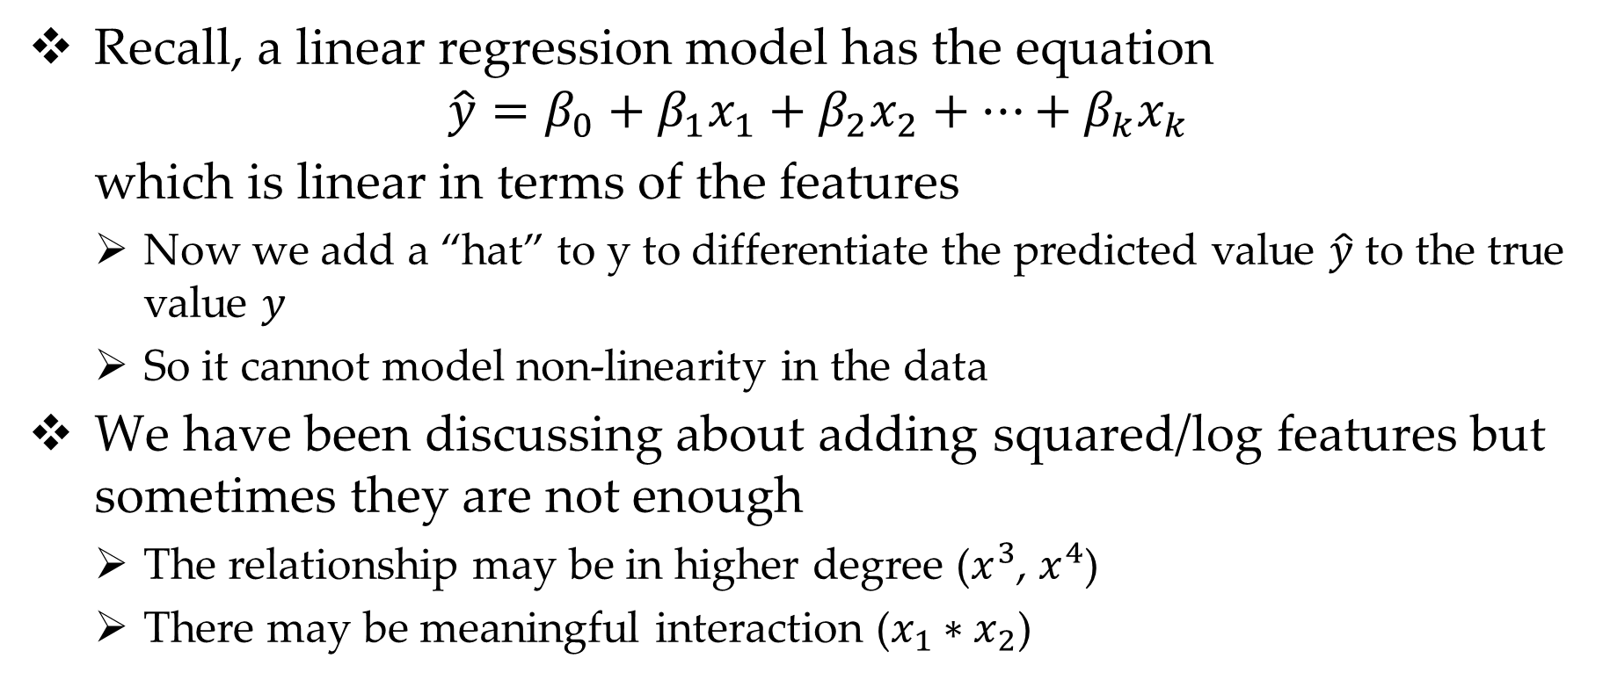
Why Polynomial Regression
Recall, a linear regression model has the equation
$$\hat{y}=β_{0}+β_{1}x_{1}+β_{2}x_{2}+…+β_{k}x_{k}$$
which is linear in terms of the features
Now we add a “hat” to y to differentiate the predicted value $\hat{y}$ to the true value $y$
So it cannot model non-linearity in the data
We have been discussing about adding squared/log features but sometimes they are not enough
The relationship may be in higher degree ($x^{3}$, $x^{4}$)
There may be meaningful interaction ($x_{1}∗x_{2}$)

Slide 3
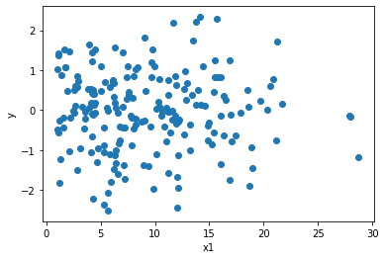
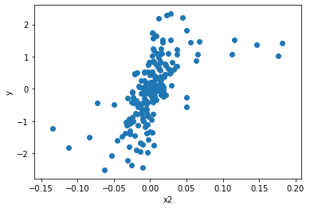
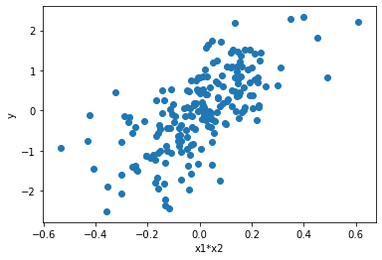
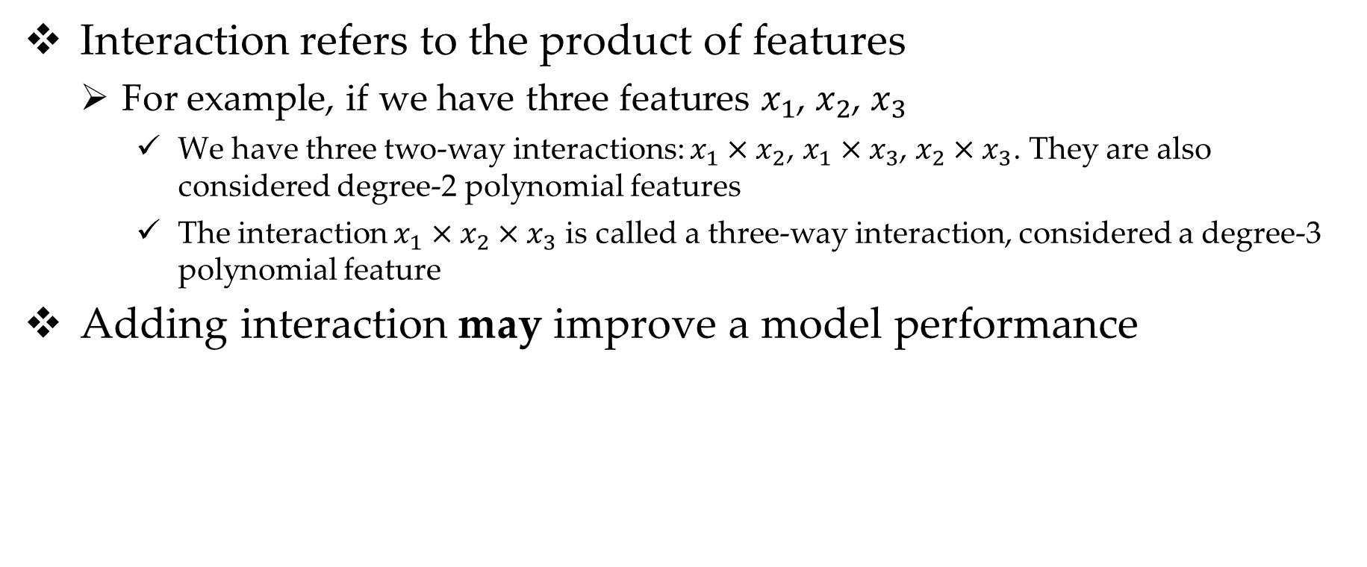
Interactions of Features
Interaction refers to the product of features
For example, if we have three features $x_{1}$, $x_{2}$, $x_{3}$
We have three two-way interactions: $x_{1}×x_{2}$, $x_{1}×x_{3}$, $x_{2}×x_{3}$. They are also considered degree-2 polynomial features
The interaction $x_{1}×x_{2}×x_{3}$ is called a three-way interaction, considered a degree-3 polynomial feature
Adding interaction may improve a model performance

Slide 4
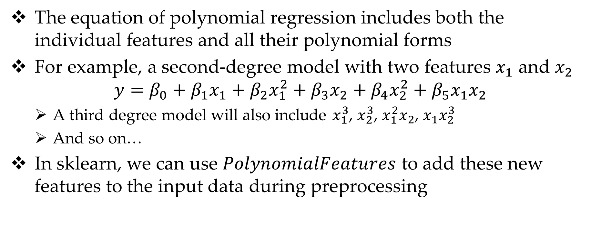
Polynomial Regression (cont.)
The equation of polynomial regression includes both the individual features and all their polynomial forms
For example, a second-degree model with two features $x_{1}$ and $x_{2}$
$$y=β_{0}+β_{1}x_{1}+β_{2}x_{1}^{2}+β_{3}x_{2}+β_{4}x_{2}^{2}+β_{5}x_{1}x_{2}$$
A third degree model will also include $x_{1}^{3}$, $x_{2}^{3}$, $x_{1}^{2}x_{2}$, $x_{1}x_{2}^{3}$
And so on…
In sklearn, we can use $PolynomialFeatures$ to add these new features to the input data during preprocessing

Slide 5



Be Careful…
Adding more polynomial features is a very easy way to overfit your training data
From the samples code (models applied on the auto-mpg data)
It can be seen that adding higher degree polynomial features makes the overfitting problem worse

Slide 6
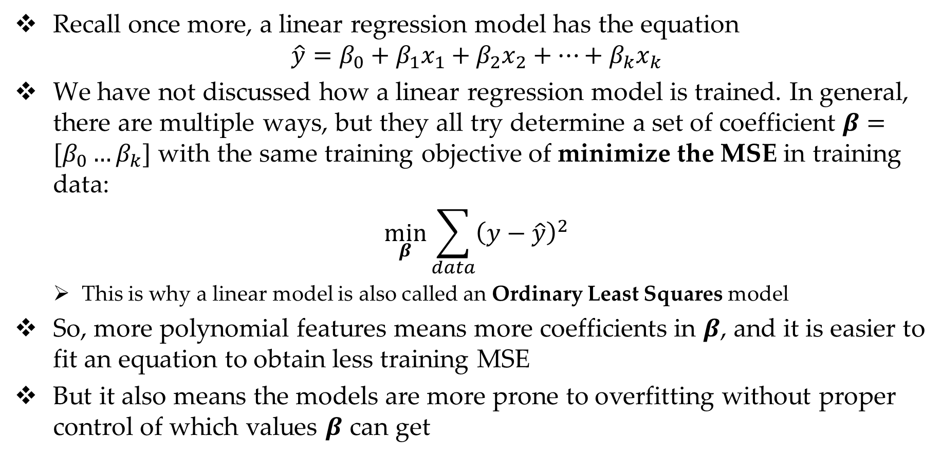
Linear Regression Revisit
Recall once more, a linear regression model has the equation
$$\hat{y}=β_{0}+β_{1}x_{1}+β_{2}x_{2}+…+β_{k}x_{k}$$
We have not discussed how a linear regression model is trained. In general, there are multiple ways, but they all try determine a set of coefficient $β=[β_{0}…β_{k}]$ with the same training objective of minimize the MSE in training data:
$$\min_{β}{\sum_{data}{{\left(y−\hat{y}\right)}^{2}}}$$
This is why a linear model is also called an Ordinary Least Squares model
So, more polynomial features means more coefficients in $β$, and it is easier to fit an equation to obtain less training MSE
But it also means the models are more prone to overfitting without proper control of which values $β$ can get

Slide 7
Higher Degree Polynomial Models Overfit Easily
Training Data
Testing Data
Training Data
Testing Data
y
x
x
Linear Model
Degree-6 Polynomial Model

Slide 8
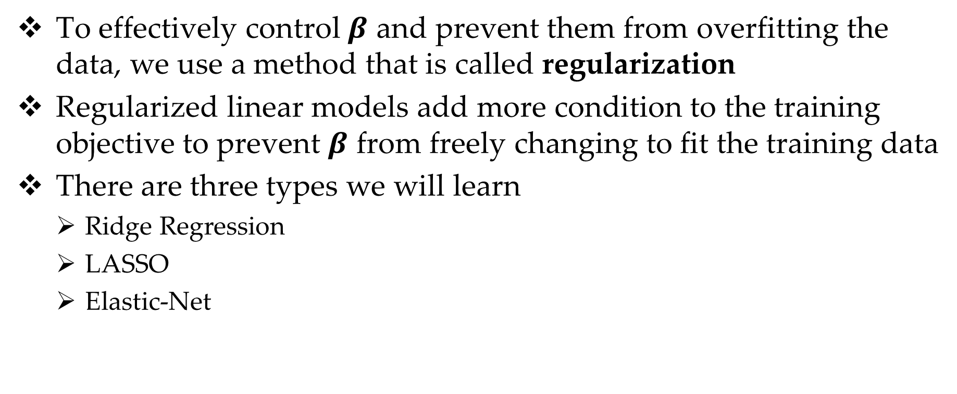
Regularization
To effectively control $β$ and prevent them from overfitting the data, we use a method that is called regularization
Regularized linear models add more condition to the training objective to prevent $β$ from freely changing to fit the training data
There are three types we will learn
Ridge Regression
LASSO
Elastic-Net

Slide 9
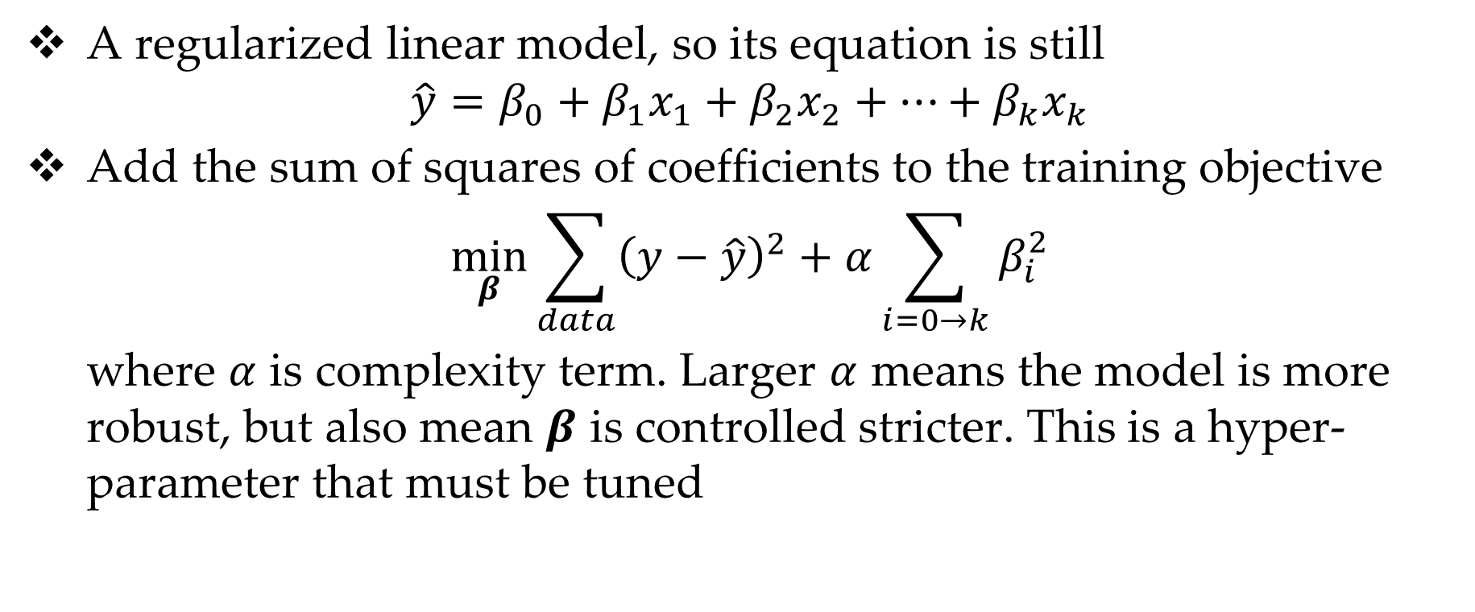
Ridge Regression
A regularized linear model, so its equation is still
$$\hat{y}=β_{0}+β_{1}x_{1}+β_{2}x_{2}+…+β_{k}x_{k}$$
Add the sum of squares of coefficients to the training objective
$$\min_{β}{\sum_{data}{{\left(y−\hat{y}\right)}^{2}}}+α\sum_{i=0→k}{β_{i}^{2}}$$
where $α$ is complexity term. Larger $α$ means the model is more robust, but also mean $β$ is controlled stricter. This is a hyper- parameter that must be tuned

Slide 10
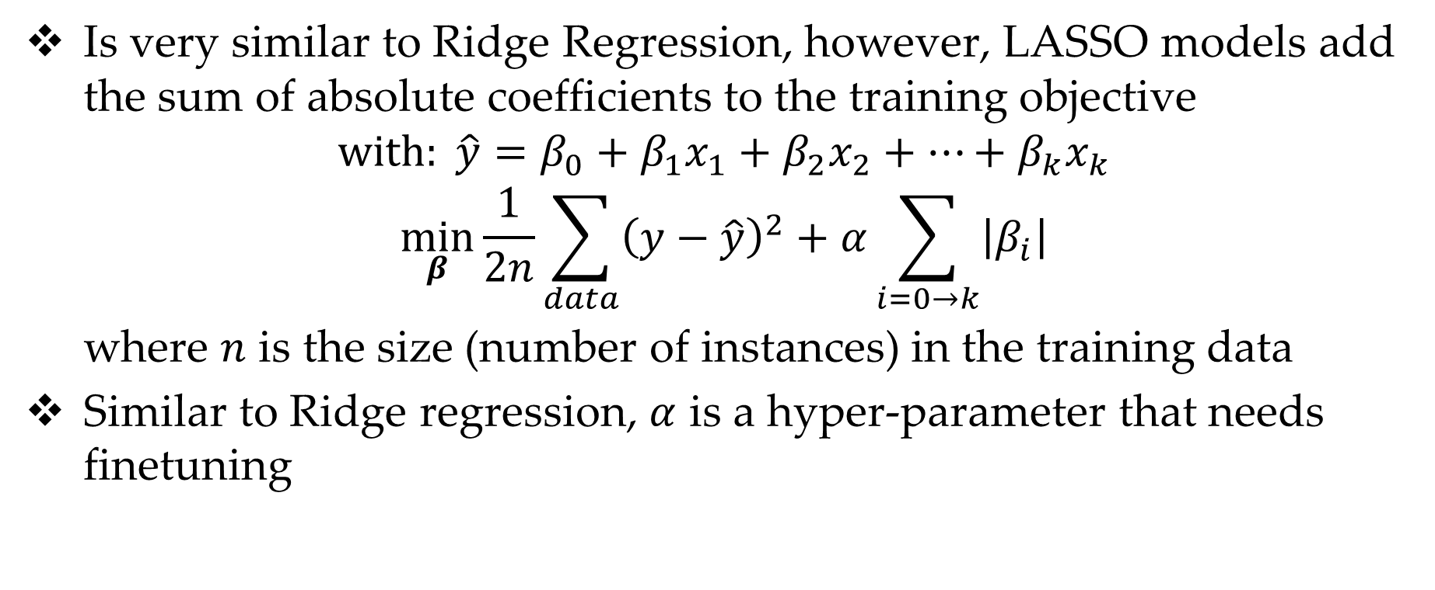
LASSO
Is very similar to Ridge Regression, however, LASSO models add the sum of absolute coefficients to the training objective
$$with: \hat{y}=β_{0}+β_{1}x_{1}+β_{2}x_{2}+…+β_{k}x_{k}$$
$$\min_{β}{\frac{1}{2n}\sum_{data}{{\left(y−\hat{y}\right)}^{2}}}+α\sum_{i=0→k}{\left|β_{i}\right|}$$
where $n$ is the size (number of instances) in the training data
Similar to Ridge regression, $α$ is a hyper-parameter that needs finetuning

Slide 11
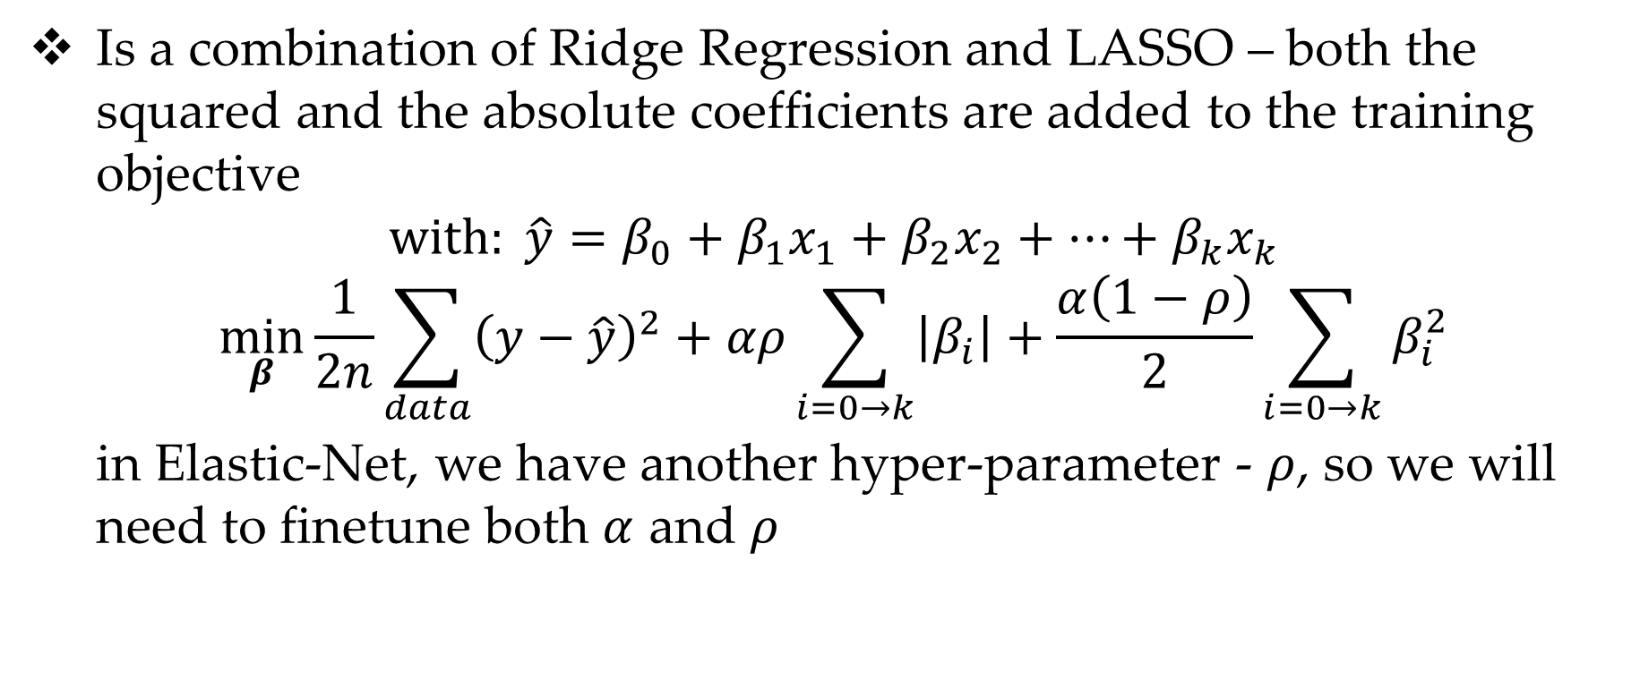
Elastic-Net
Is a combination of Ridge Regression and LASSO – both the squared and the absolute coefficients are added to the training objective
$$with: \hat{y}=β_{0}+β_{1}x_{1}+β_{2}x_{2}+…+β_{k}x_{k}$$
$$\min_{β}{\frac{1}{2n}\sum_{data}{{\left(y−\hat{y}\right)}^{2}}}+αρ\sum_{i=0→k}{\left|β_{i}\right|}+\frac{α\left(1−ρ\right)}{2}\sum_{i=0→k}{β_{i}^{2}}$$
in Elastic-Net, we have another hyper-parameter - $ρ$, so we will need to finetune both $α$ and $ρ$

